Slide 1




Internet of Vehicles (IoV) Network Packet Analysis (NPA) for Intrusion Detection Systems (IDS)
SAAD ALI

Slide 2
Content
1. Use Case
2. Data
3. Feature Engineering
4. Machine Learning and DeepLearning Models

Slide 3
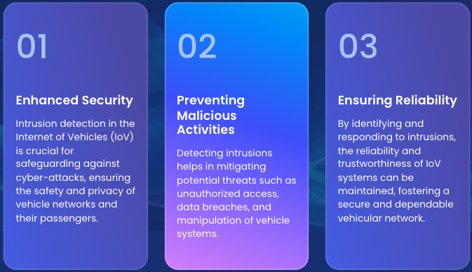
Section 1: use case

Slide 4
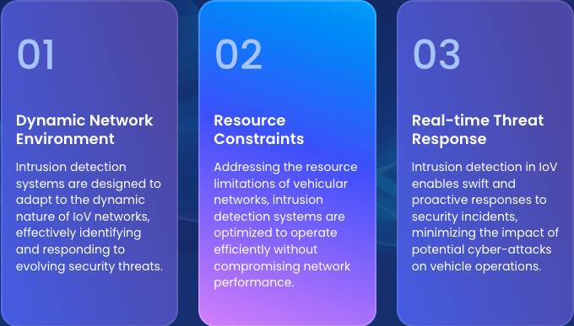
Section 1: use case

Slide 5
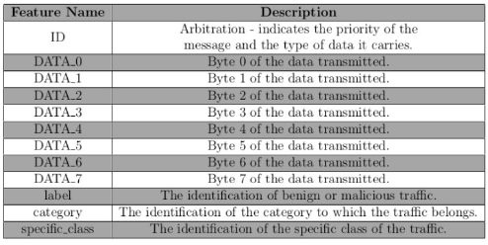
SECTION 2: DATASET
Canadian Institute for Cybersecurity 2024 Iov dataset containing csv files of binary, hexadecimal, and decimal formats of network packets
Datasets were either benign or malicious, further categorized by attack vector (DoS, spoofing type of spoofing, etc.)

Slide 6
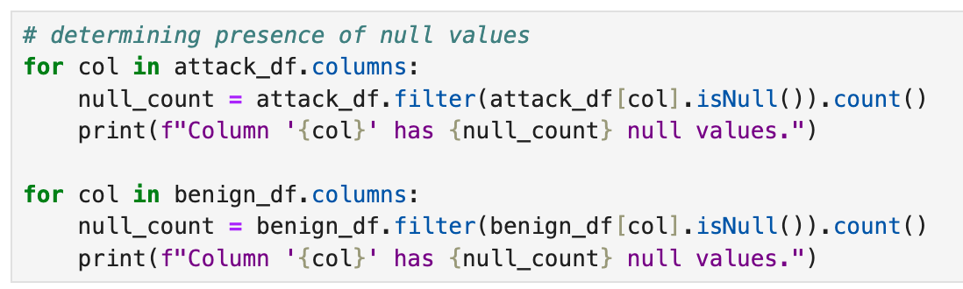
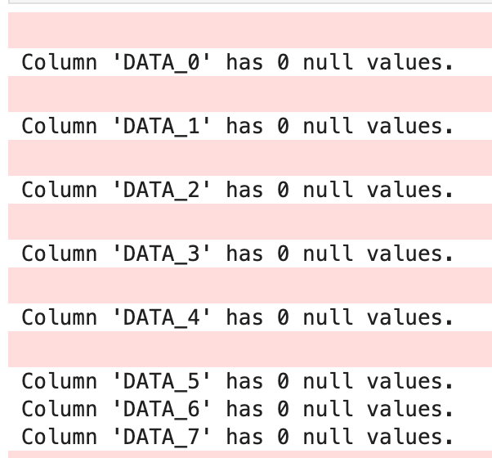
Section 2: data Quality
As this is network packet data, only null values had to be accounted for in case of dropped/missing packets.
No null values were found

Slide 7
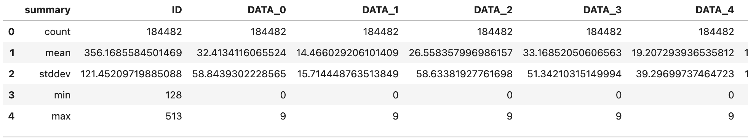
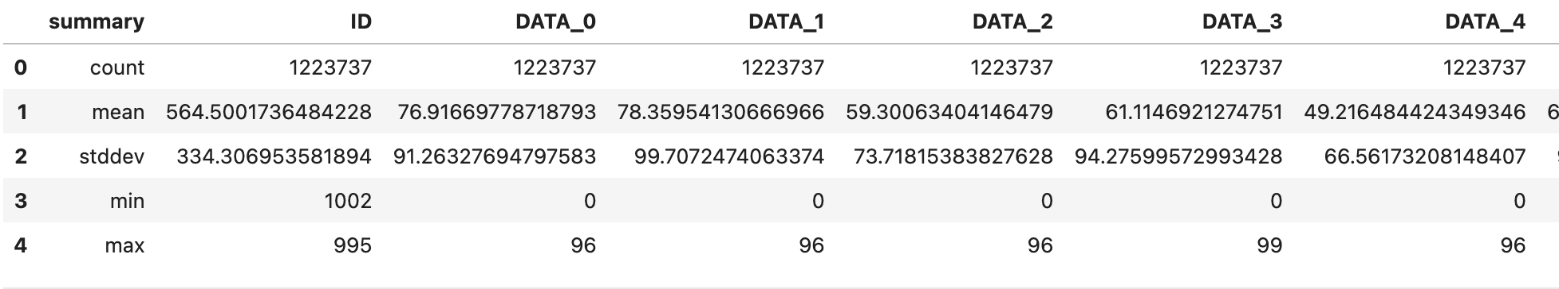
Section 2: data exploration

Slide 8
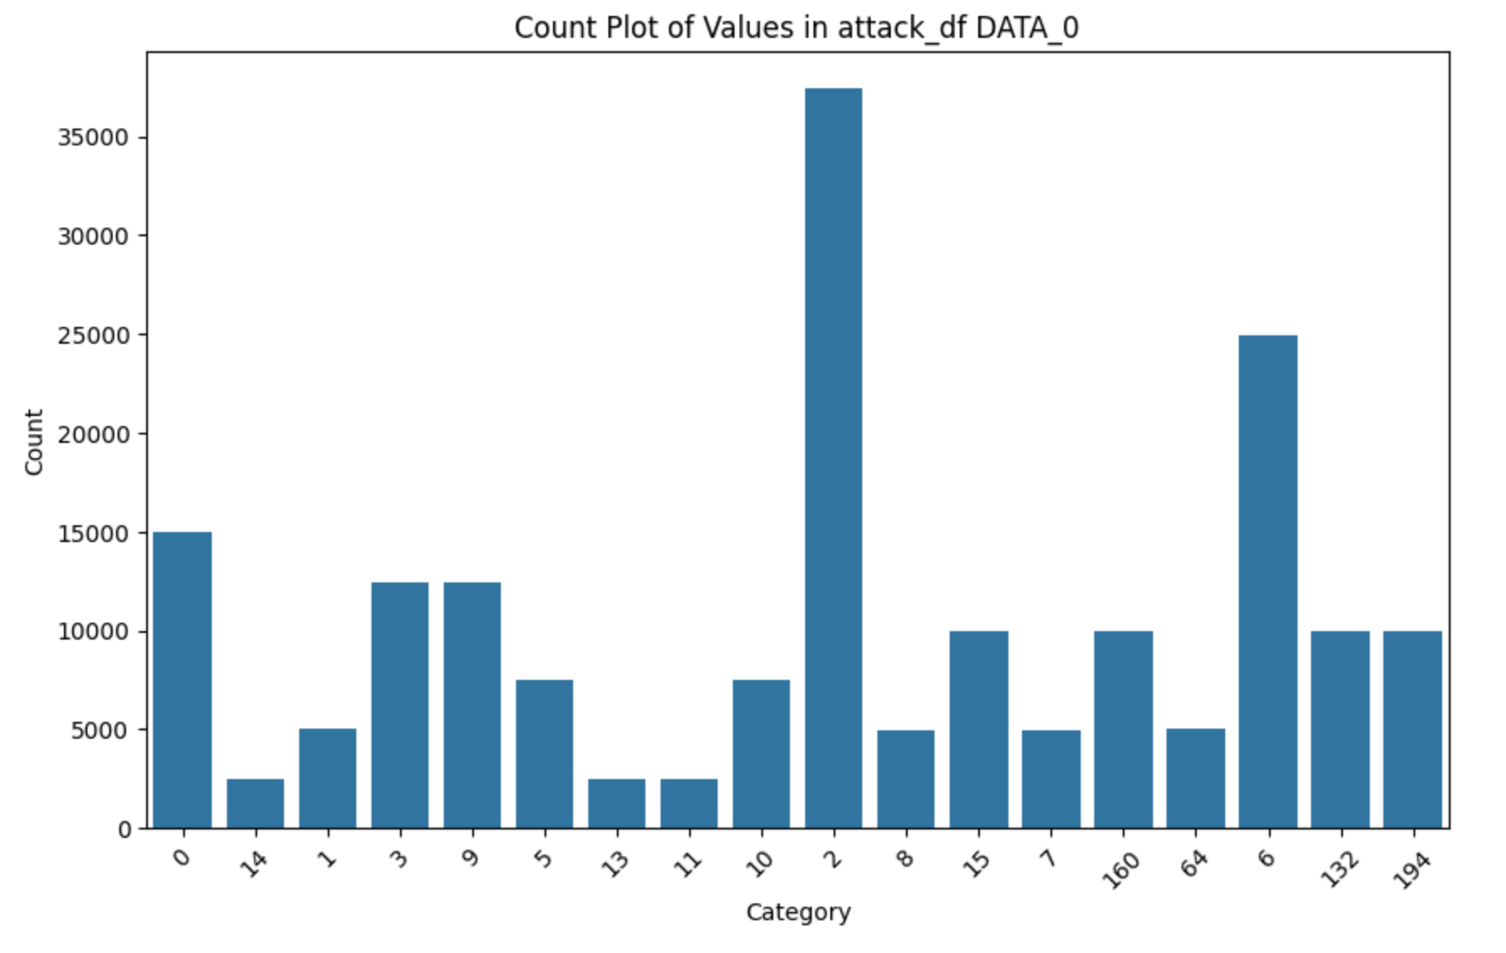
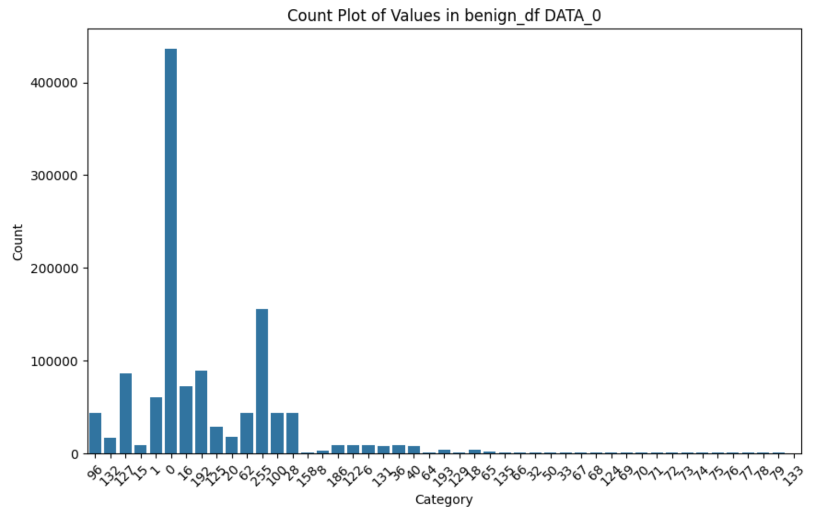
SECTION 2: DATA VISUALIZATION

Slide 9
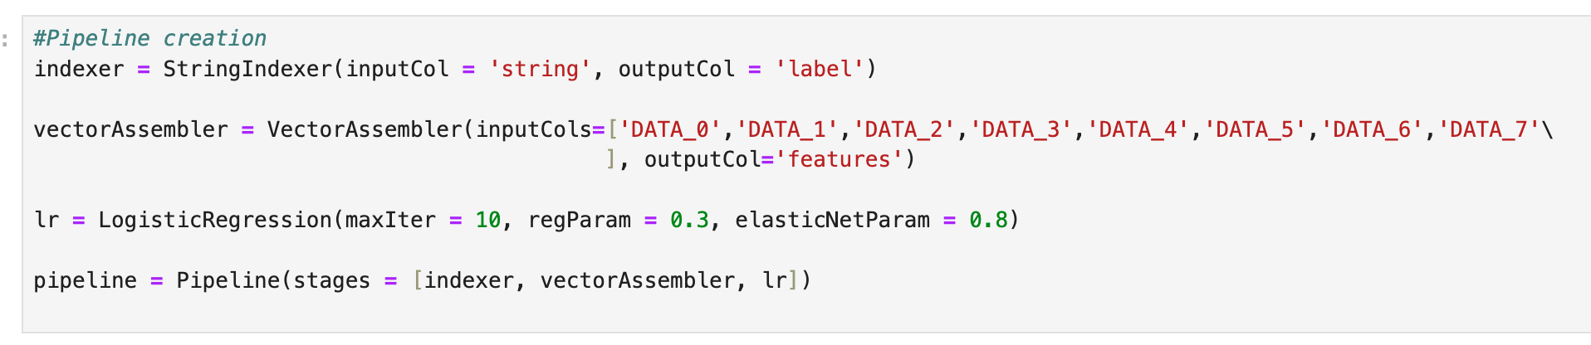
sECTION 3: FEATURE ENGINEERING – lOGISTIC REGRESSION

Slide 10
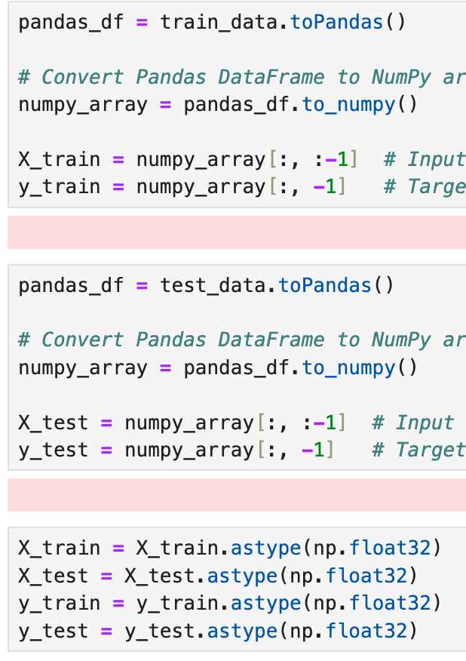
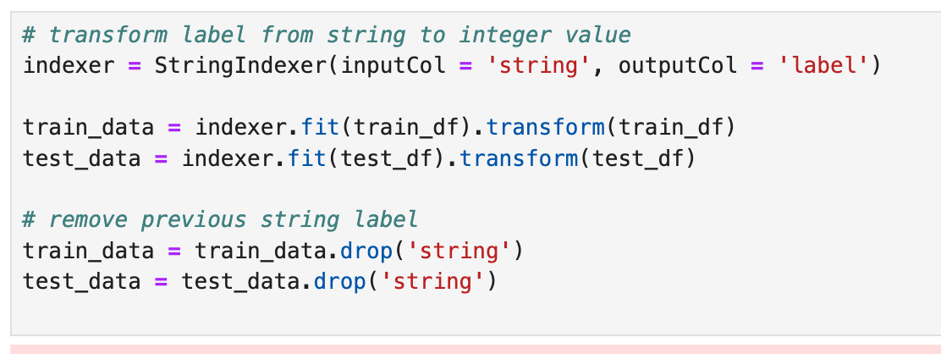
sECTION 3: FEATURE ENGINEERING – aNOMALY DETECTOR

Slide 11
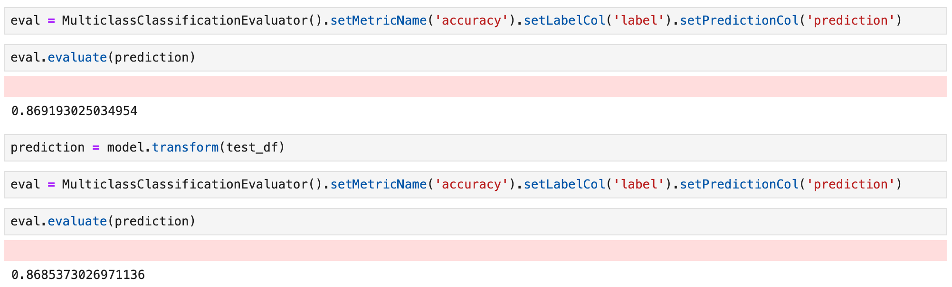
sECTION 4: lOGISTIC REGRESSION

Slide 12
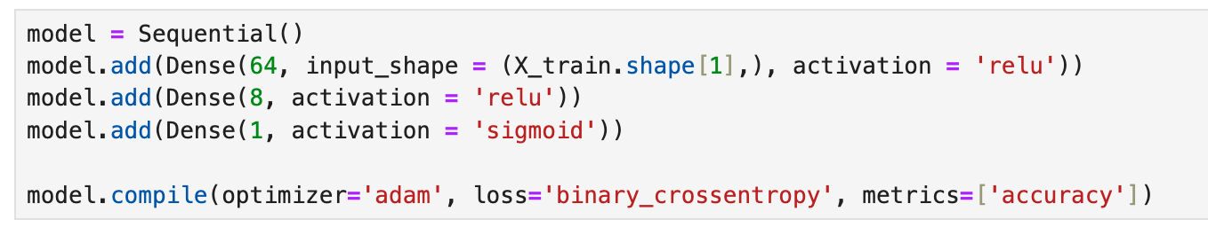
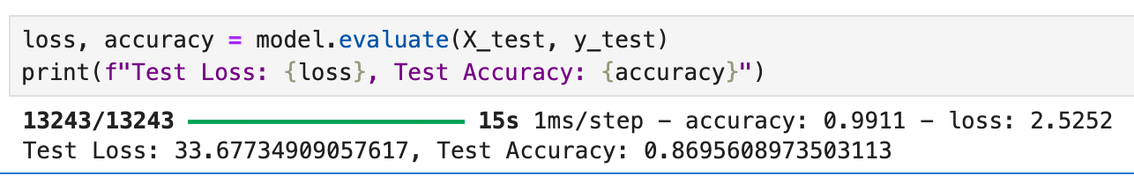
Section 4: Anomaly detector

Slide 13


Thank you

